Slide 1

E-Commerce OLIST STORE ANALYSIS
Presented by Group 3

Slide 2
GROUP MEMBERS
Ms. ANANYA ANAND
Mrs. ANJALI SURAJ PARDESHI
Ms. PREETHI M
Ms. SHRUTI SWAMI
Ms. SRUSTI S PATIL
Ms. VAISHNAVI SHIVAJI LONKAR

Slide 3
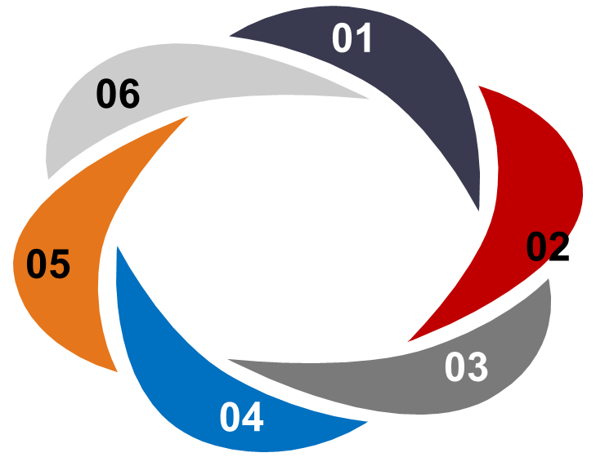

AGENDA
Overview
Introduction
KPI’s
Insights and Improvements
Conclusion

Slide 4
OVERVIEW
Olist Store Analysis project deals with analyzing customer purchase patterns and payment statistics on an E-Commerce platform.
The analysis is based on nine CSV files which are cleaned and manipulated to extract valuable insights.
Here in this project, analysis is done on various fields such reviews, orders, payments, payments type, order dates , delivery dates etc.
Also certain Key Performance Indicators (KPI) are covered which enhances as well as gives more information in the dashboard.

Slide 5
INTRODUCTION
Olist Store is an E-Commerce platform based in the Brazil that allows small and medium-sized businesses to sell their products online.
Olist provides a marketplace where sellers can list their products and reach a larger customer base, as well as tools to help manage their online store, track orders, and handle customer support.
The primary goal of this project is to :-
Identify insights and trends that can help improve the overall performance business.
Identifying top–performing products and categories.
Analysing customer behaviour and preferences.
Analysing sales and revenue trends over time.
Identifying factors that contribute to customer retention.

Slide 6
KPI’S
Weekday Vs Weekend Payment Statistics.
Number of Orders with review score 5 and payment type as credit card.
Average number of delivery days taken for pet shop.
Average price and payment values from customers of Sao Paulo city.
Relationship between shipping days Vs review scores.

Slide 7
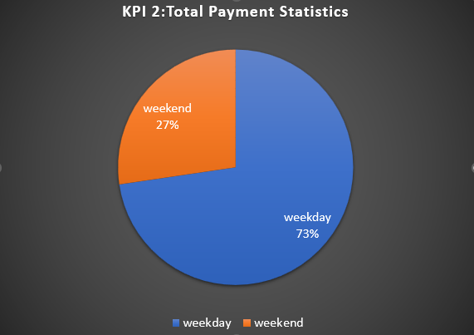
Weekday Vs Weekend Payment Statistics
The analysis of payment statistics based on weekday vs weekend provides an understanding of the buying behavior of customers.
This KPI answers questions such as which day of the week has the highest sales ?, how many customers prefer to pay through online modes?
The analysis of this KPI can help Olist to improve their weekend sales and plan promotions accordingly.

Slide 8
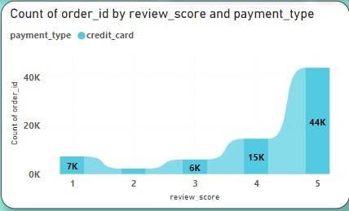
Number of Orders with review score 5 and payment type as credit card.
This KPI analyses the number of orders with a review score of 5 and payment type as credit card.
This helps us in understanding customer satisfaction levels as well as their preferred payment type.
This gives the olist platform an idea to know about the purchases having the highest review and recommend similar products which in turn increases the revenue.
Certain improvements can be done in other payment type such as Boleto , vouchers, debit card etc.

Slide 9
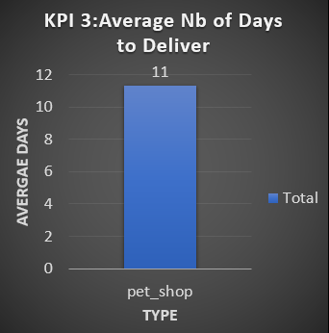
Average number of delivery days taken for pet shop.
This KPI analyzes the average number of days taken for order_delivered_customer_date for pet shop.
It helps Olist in identifying the areas where they need to improve and speed up their delivery time and also maintain customer satisfaction.
Also , this KPI helps in following the same results for pet shop and apply it in other categories as well for more sales.

Slide 10
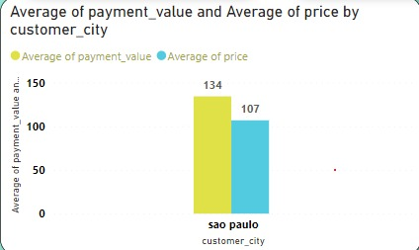
Average price and payment values from customers of Sao Paulo city.
Olist Store Analysis project also indicates that, Sao Paulo city is one of the most popular city of Brazil, and the approximate average price in this city is 107 and average payment value is 134.
The analysis of average price and payment values from customers of Sao Paulo city helps in understanding the spending patterns of customers in this region.
It also helps Olist store in identifying areas of improvement, high-value customers and creating targeted marketing campaigns.

Slide 11
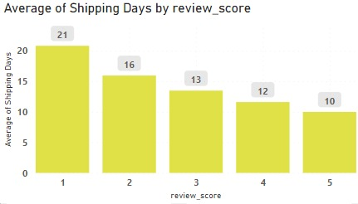
Relationship between shipping days Vs review scores
This KPI analyzes the relationship between shipping days and review scores.
It helps in understanding the impact of delivery time on customer satisfaction levels.
Olist can use this information to optimize their logistics and improve their delivery time.

Slide 12
INSIGHTS
According to the given data , Olist E-commerce has about 99,440 orders with 89,940 orders delivered , company has a 90% delivery success rate , Average product rating is 4.05 stars , with product categories going as high as 4.67 stars and as low as 2.5 stars.
Delivery performance could also influence review scores and success rate could be improved.
Insights from this analysis can help in making better business decisions such as focusing on products that customers are interested in , improving service and product quality and making the marketing process feasible for customers for high sales.
Also it provides an insight on the overview of customers consumption trends and patterns that can be used to direct further business strategies.

Slide 13
IMPROVEMENTS
Regularly monitoring and analyze customer reviews to gain insights in product quality and identify areas for improvement.
Investigating delivery delays and undelivered orders.
Providing proper shipment tracking system aids in having a clear and concise communication between customers , sellers and couriers. Regular updates can set proper expectations among customers and specific delivery instructions of customers can be properly accommodated.
Analyzing geographic locations can bring insights about certain challenges and possible route optimization.

Slide 14
CONCLUSION
Overall, regular monitoring of customer reviews, real time tracking of fleet performance together with proper shipment tracking and communication system can improve Olist’s delivery and ensure customers are highly satisfied with the service.
The olist store analysis project provides valuable insights into customer behaviour and payment statistics.
The analysis of these KPIs helps Olist in identifying areas of improvement and creating targeted marketed campaigns.
This project serves as a great example of how data analysis can make help businesses make informed decisions.

Slide 15
THANK YOU…..

